Slide 1
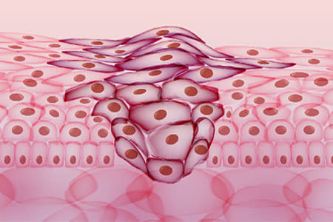
DETECTION OF
MELANOMA USING IMAGE PROCESSING TECHNIQUES
DIGITAL IMAGE PROCESSING – SWE1010
PROJECT REVIEW
COURSE CODE: SWE1010
FACULTY: Dr. Geetha S

Slide 2
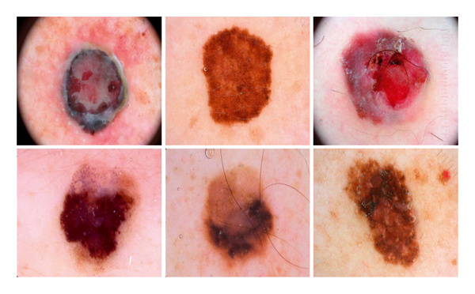
TEAM MEMBERS
PRANAV SUMESH - 20MIS1034
DONTHU SAI NAGA VENKATA AJAY RAGHAVA - 20MIS1176
ARUNESS PRAKASH - 20MIS1118
DIGITAL IMAGE PROCESSING
SWE1010
Dr. GEETHA S

Slide 3

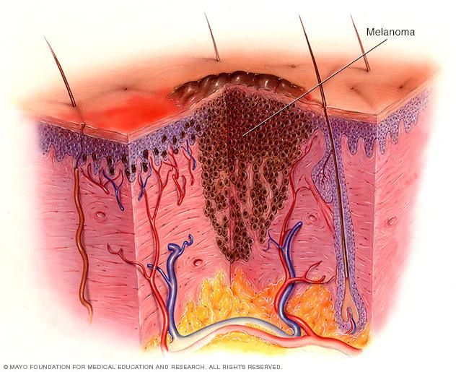
PROBLEM STATEMENT
ABOUT MELANOMA:
Melanoma is the most serious category of skin cancer.
It generally develops in melanocytes - the cells that produce the pigment melanin - which gives our skin its color.
Additionally, melanoma can develop in your eyes and, very rarely, inside your body, like in the throat or nose.
Although the precise causation of melanoma is unknown, exposure to ultraviolet (UV) radiation from sunshine, tanning beds, or tanning lamps increases the risk of acquiring the disease.

Slide 4
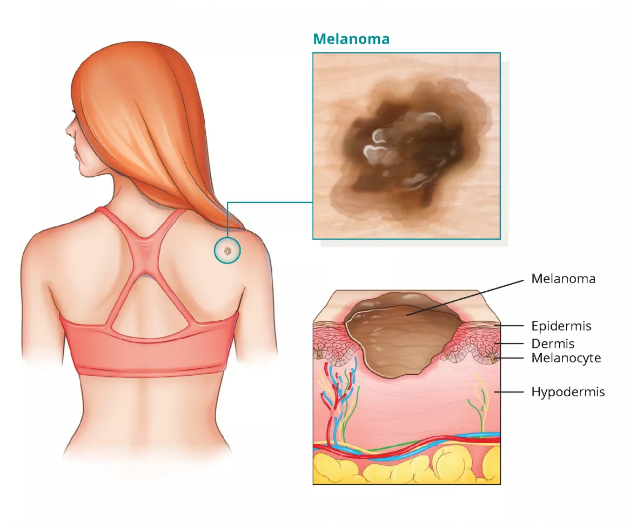
PROBLEM STATEMENT
Melanoma appears to be rising among those under 40, particularly women.
The detection and successful treatment of malignant changes prior to the development of the cancer can be facilitated by being informed of the warning symptoms of skin cancer.
If melanoma is found early on, it can be successfully treated.

Slide 5
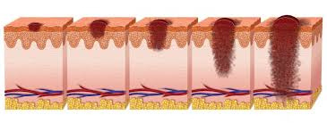
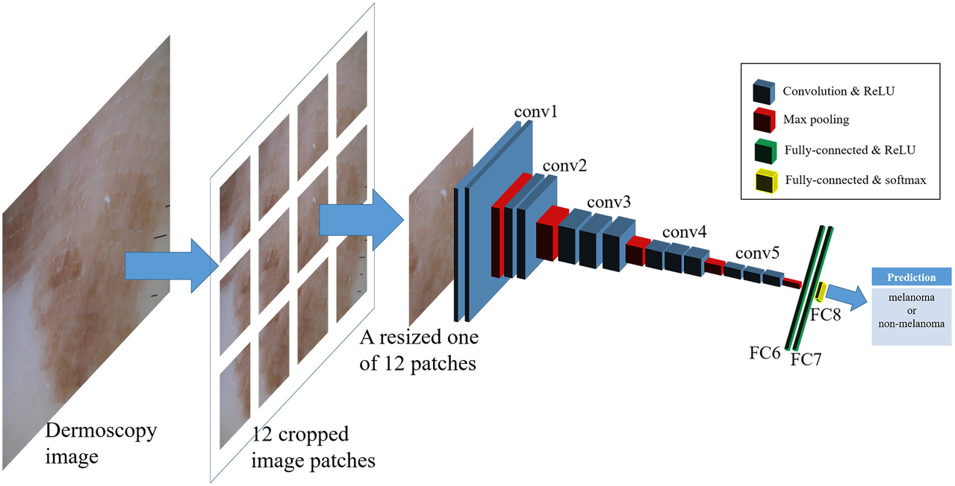
ABSTRACT
The aim of this project is to create an automated melanoma detection system utilizing digital image processing and machine learning .
Following the segmentation of the provided dermoscopic pictures, the damaged skin cells' features are extracted using a feature extraction technique.
The stratification of the extracted features is done using a convolutional neural network classifier.
The system will be able to identify any early melanoma symptoms, so that the user can immediately address the issue before the cancer cells multiply rapidly.

Slide 6
METHODOLOGY
The BF approach is used to reduce noise in dermoscopic images at the most fundamental level.
Dermoscopic images include noises like salt and pepper and Gaussian noise, among others.
The data are kept close to the input data after the noise has been removed.
This input image was denoised using the BF method.BF performed the spatial weight averaging without using the smoothing edge.
In order to provide filtering in both the spatial and intensity domains, this filtering combines two Gaussian filters; another one is already in operation.
The segmented images are loaded into the NasNet model to create feature vectors.
Along with several hidden convolutional layers, CNN consists of input and output layers.

Slide 7
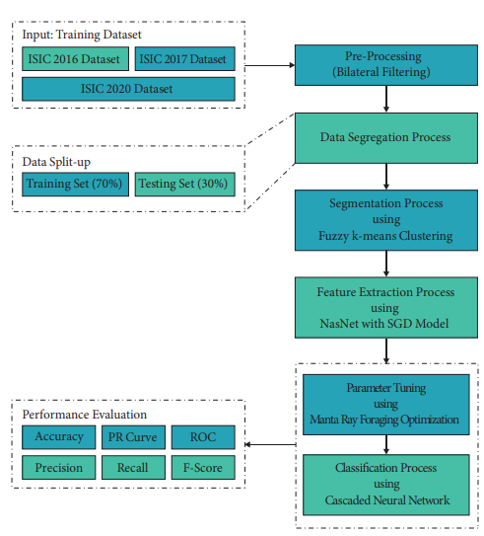
Overall block diagram of CIMDC-DI technique

Slide 8
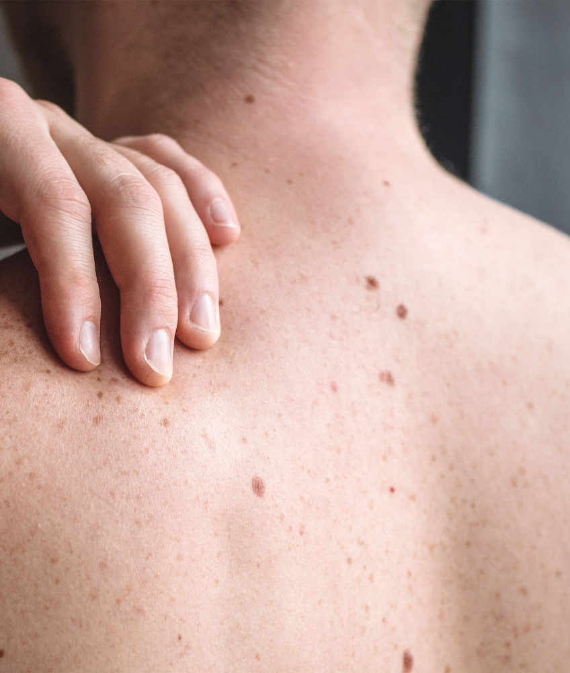
CONCLUSION
With more technological advancements and breakthroughs in the field of Image Processing, the existing systems can be enhanced to improve the quality and the speed of the process, making better predictions.

Slide 9

REFERENCES
https://www.hindawi.com/journals/cin/2022/2370190
https://www.mayoclinic.org/diseases-conditions/melanoma
https://www.researchgate.net/publication/334751850_Skin_Cancer_Detection_Using_Convolutional_Neural_Network

Slide 10
THANK YOU!

